Slide 1

Mechanisms for Mobilization and Support of Health Facility Managers: the Role of the Association of Health Facility Managers of the Kyrgyz Republic
Maanaev Toktobay Israilovich
Chairman of the Board of the AHFM Public Association of the KR
NATIONAL FORUM OF HEALTH FACILITY MANAGERS
Bishkek, January 28, 2022

Slide 2

"Association of Health Facility Managers of the Kyrgyz Republic" Public Association
Organizational and legal form - public association of individuals (voluntary);
The full name in the state language is “Kyrgyz Respublikasynyn Salamattyk saktoo uyumdarynyn zhetekchilerinin associationsy” koomduk birikmesi;
Abbreviated name: in the state language - "KR SSU ZHA" Kb
in the official language - OO "AROZ KR";
Date of registration - December 8, 2020

Slide 3
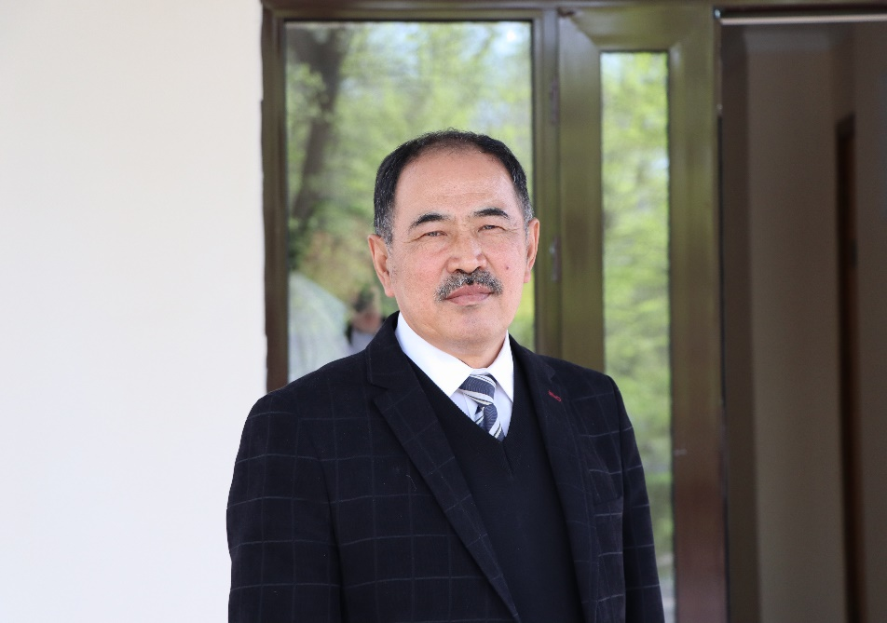
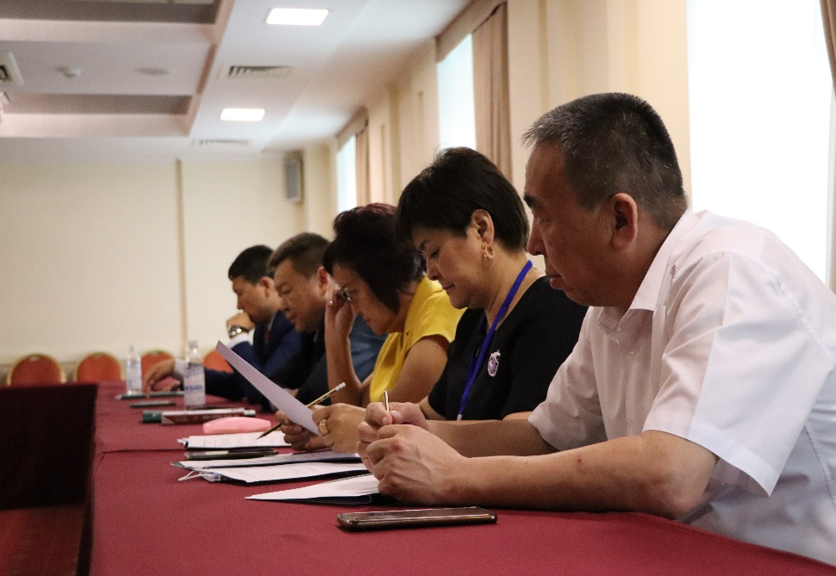
Management and Control Bodies of the AHFM of the KR
General Meeting of the Association members (the supreme governing body, meets at least once a year);
The Board of the Association (collegiate management body) consists of 12 people representing all regions of the Kyrgyz Republic;
Chairman of the Board of the Association –
Maanaev Toktobay Israilovich;
Audit Commission:
Maykanaev Bolotbek Bektashevich Musabayeva Damira Sultanovna
Sultanaliev Mirlan Kadyrbekovich

Slide 4
List of members of the Board of AHFM of the KR
1. | Tilekov Ernis Abdyshevich | Bishkek
2. | Usupbekov Nurdin Sarymsakovich | Talas region
3. | Tashpolotov Kyyalbek Zhanybekovich | Osh region
4. | Arstankulov Talantbek Kurbanalievich | Osh region
5. | Botokaraev Kumarbek Pazylovich | Jalal-Abad region
6. | Borubekov Arzybek Kursanalievich | Batken region
7. | Isaeva Baktygul Kedeykanovna | Chui region
8. | Narmatova Elmira Baltabaevna | Osh
9. | Zhaylymysheva Beishekan Arunovna | Issyk-Kul region
10. | Beishenaliev Ilimgazy Aiypovich | Naryn region
11 | Omuraliva Munarkan Azimovna | Bishkek

Slide 5
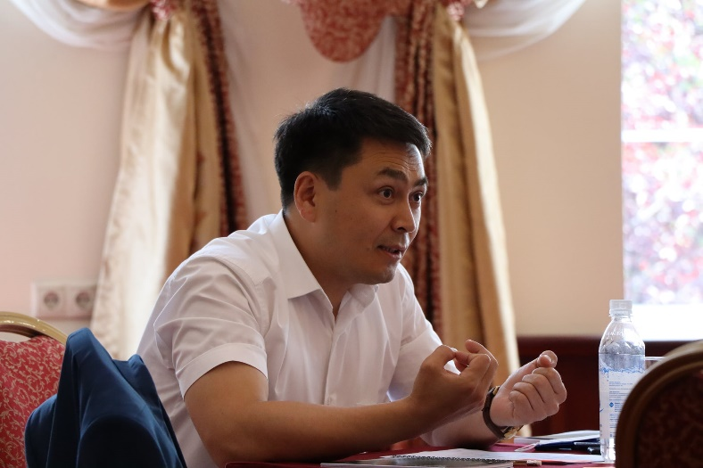
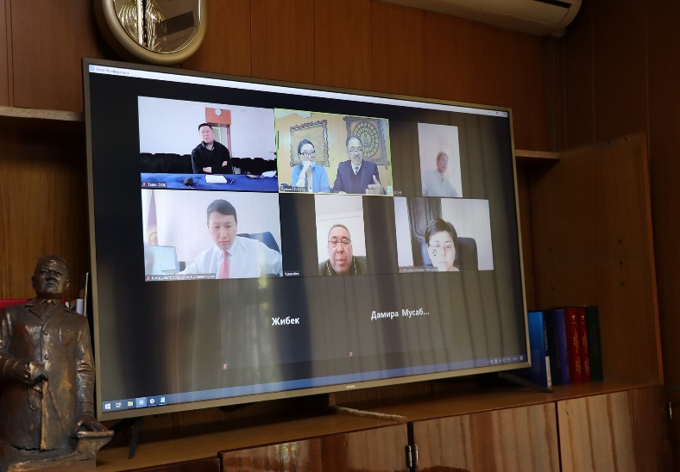
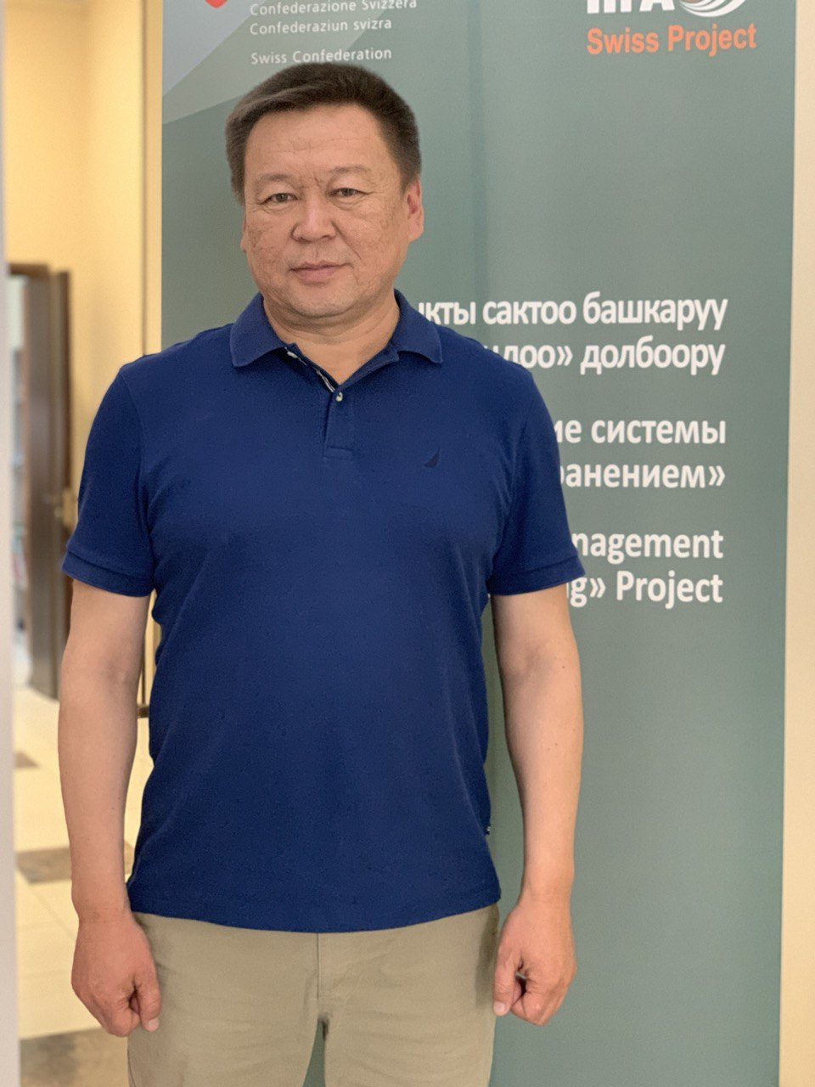
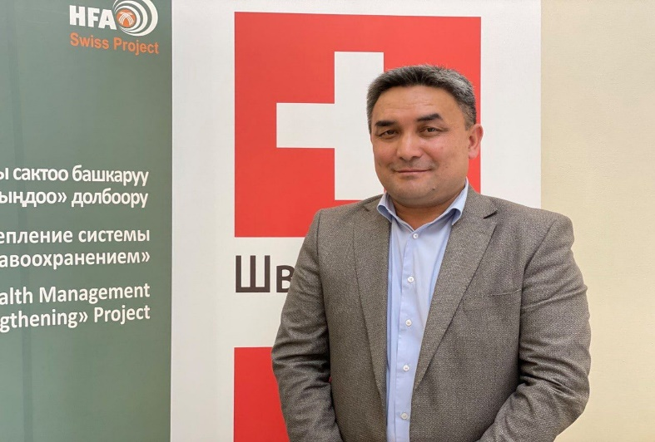
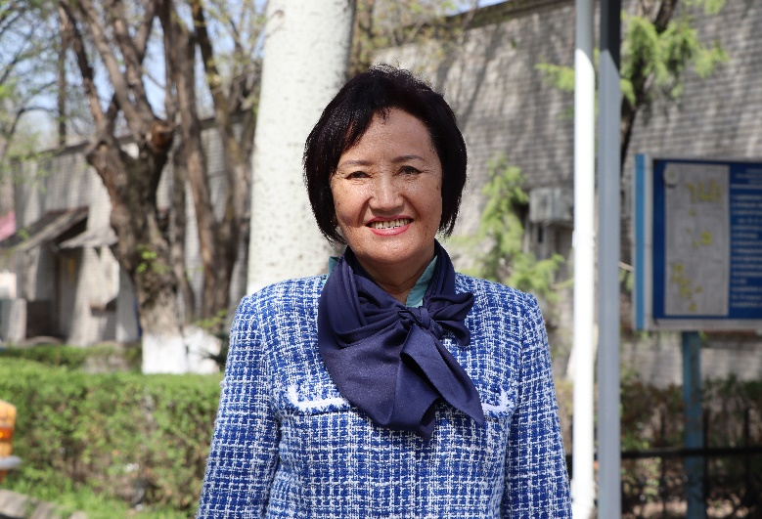
We are together - and this is our strength!

Slide 6
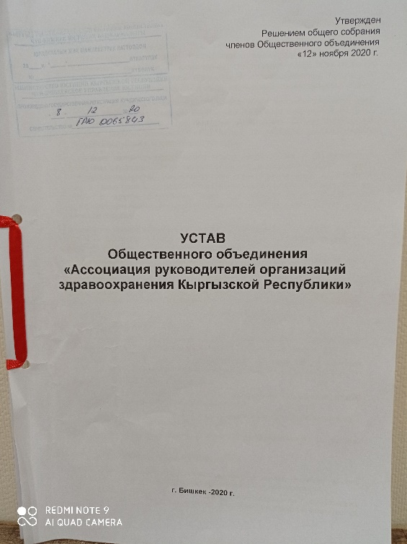
Constituent and organizational documents of the AHFM of the KR
Charter of the "Association of Health Facility Managers
of the Kyrgyz Republic” PA;
Regulations of the Board of the "Association of Health Facility
Managers of the Kyrgyz Republic” PA;
Provisions on membership in the "Association of Health Facility
Managers of the Kyrgyz Republic” PA;
Provisions on the Executive Director of the "Association of Health Facility
Managers of the Kyrgyz Republic”;
2021-2023 Organizational development plan of the "Association of Health Facility Managers of the Kyrgyz Republic” PA

Slide 7

2021-2023 Organizational development plan of the AHFM of the Kyrgyz Republic (1)
Mission of AHFM of KR:
Assistance in development of a sustainable and efficient management system for health facilities by strengthening the interaction of all stakeholders, including health facility managers, to improve the quality and accessibility of medical care to the population of the Kyrgyz Republic
Strategic directions of activities:
Assistance to the MHSD KR in creating favorable conditions to strengthen the health facilities’ management: improving the legislative framework through the development and systematization of normative legal acts and regulatory mechanisms;
Participation in capacity building of health facility managers on health management issues;
Improving the institutional and financial sustainability of the AHFM of the KR.

Slide 8
2021-2023 Organizational development plan of the AHFM of the Kyrgyz Republic (2)
Objective 1. Assistance in improving the quality of health facilities’ management;
Objective 2. Strengthening the system of health facility managers’ knowledge and skills development;
Objective 3. Strengthening the interaction between the health facility managers and international cooperation development;
Objective 4. Strengthening the strategic and operational management of the AHFM of the KR

Slide 9
2021-2023 Organizational development plan of the AHFM of the Kyrgyz Republic: implementation (3)
Detailed activities have been developed to implement of the tasks outlined in the Development Plan of the AHFM of the KR;
The Chairperson and members of the Board, the Executive Director are members of various Working Groups of the Ministry of Health of the Kyrgyz Republic on the legal documents development (including health management issues);
The Communication Plan of the AHFM of the KR for 2022 has been prepared and is being implemented in stages;
The corporate image of the organization was developed and approved by the Board;
Members of the Board participated in the revision of existing laws and regulations on the staff, knowledge and skills management in the field of health management;

Slide 10
2021-2023 Organizational development plan of the AHFM of the Kyrgyz Republic: implementation (4)
The "Ethical Code of the Health Facility Manager in the Kyrgyz Republic" was developed and approved;
The “Regulations on Awarding Members of the AHFM of the KR PA” were developed and approved;
Websites of AHFM of the KR and CHD&MT were created on a grant from the Soros Foundation-Kyrgyzstan;
Capacity assessment passed in the Commission for the Accreditation of Professional Medical Associations under the Ministry of Health of the Kyrgyz Republic (AHFM of the KR took the certification procedure for health facility managers);
Conducted two certifications to assign the qualification category of health facility managers on the AiTest platform;
The National database (registry) of health facility managers in the Kyrgyz Republic is being formed;
Facebook page launched and regularly maintained

Slide 11
What is AHFM of the KR planning to do for its members
Provide legal, informational and methodological support by providing a wide range of consulting services;
Represent the professional interests of health facility managers at the state level;
Implement and protect the health facility managers’ rights;
Participate in the development and evaluation of retraining and advanced training programs for health facility managers;
Assist in ensuring the availability and timeliness of retraining and advanced training of members - health facility managers;
Participate in the processes of forming a personnel reserve, selecting managers for positions and supporting their activities;
Facilitate the implementation of an updated performance appraisal system for the health facility managers, including the use of attestation results, and control it;
Provide other necessary assistance and support to its members

Slide 12
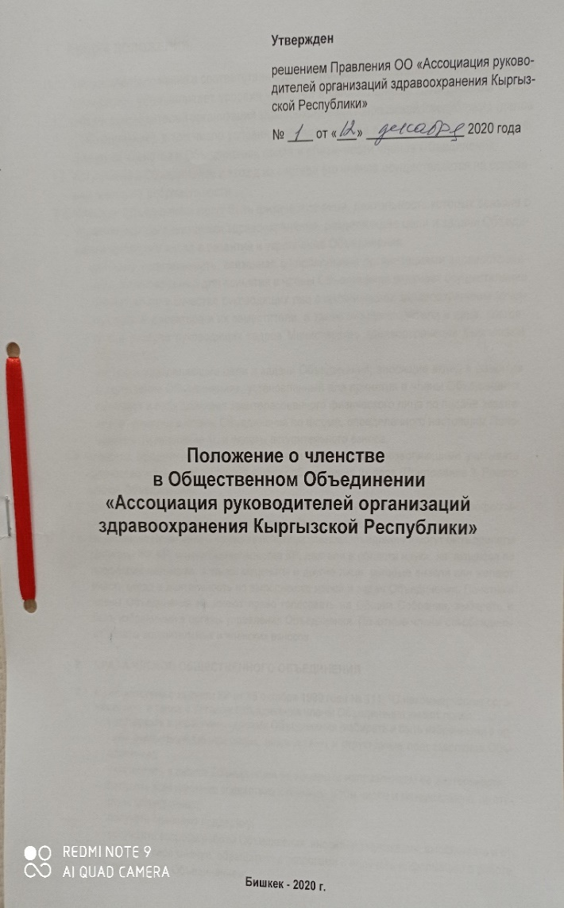
The procedure for joining the members of the AHFM of the KR
Admission to the membership of the Association is carried out on the basis of a personal written application in the form approved by these Regulations, which is submitted to the Executive Body of the Association;
The executive body of the AHFM of the KR collects applications and submits them for consideration at the next meeting of the Board;
The applicant is considered accepted as a member of the AHFM of the KR from the day the decision is made by the Board;
The decision on admission of the applicant to the members of the AHFM of the KR is communicated to the applicant within 10 days.
ENTRY AND MEMBERSHIP FEES
The amount of the entrance fee to the AHFM of the KR is determined by the Board. The entrance fee is approved in the amount of 1000 soms and is paid at a time when applying for admission;
The amount of membership fees is set at 500 soms and is paid in the same way as the entrance fee to the Executive Body of the AHFM of the KR;
Membership in AHFM of the KR is automatically suspended in case of non-payment of the fee for a period exceeding 3 months.

Slide 13
We have only the path to development ahead of us!
You can't stand aside, you need to unite!
Site: www.ahm.org.kg
Facebook: @AROZKG
https://www.facebook.com/AROZKG

